Slide 1


Science, Compliance
& the Judgment Call
10-May-2022
Anders Vinther, PhD
VP Quality Kronos Bio

Slide 2
Session Description and Objectives
Description
Objectives
Finding the right balance between science and compliance is important to ensure both a reliable supply of medicines to patients and to implement continuous improvement changes
Finding a healthy balance of the two and the importance of the judgment call is discussed
The global regulatory complexity for approval of Post Approval Changes (PAC) disincentivizes continual improvement; a problem that has been known for more than two decades
Solutions to this problem are discussed; these would get scientific advances closer to real time implementation
An appreciation that without a healthy balance of science and compliance stagnation, confusion or worse may happen
Understand the need for Quality leaders to make quality exciting and ensure employee engagement
Create an awareness of the regulatory complexity for PACs and that solutions are available
Encourage industry and regulators to pursue scientific advancement and remove barriers that slows down the implementation of PACs

Slide 3
Anders Vinther PhD
Biography and Contact Information
30+ years global experience in creating or improving quality, businesses, and work cultures
Co-founded, merged, improved compliance and turned-around companies
Senior positions in small and large companies: Novo Nordisk, AGC Biologics, Genentech, Roche, Sanofi, Intarcia, Kronos Bio
Co-leader of the 1VQ on PAC Initiative
Life-long learner; I believe that everything is possible - some things just take longer
avinther@kronosbio.com

Slide 4
What’s the Right Balance ?
1
SCIENCE
COMPLIANCE
SCIENCE
3
COMPLIANCE
COMPLIANCE
2
SCIENCE

Slide 5
The GMPs Developed as a Reaction to Fatal Incidents
The “Jungle”
Chicago meat packing industry
Diethylene contaminated elixir sulfanilamide; >100 people died
Thalidomide causing infant deformities; >10,000 cases in Europe
1906
1938
1962
Illegal to sell adulterated food or meat
Drug Products must be Safe
Drug Products must be Efficacious
Pure Food and Drug Act
FDA established
Federal Food, Drug, and Cosmetic Act (FD&C Act)
Kefauver-Harris Drug amendment to the FD&C Act
Other important activities
1963
First GMP Regs
21 CFR Part 133
No requirement for a Quality Unit
1979
‘Modern’ GMP
21 CFR Part 210 & 211
Applies to Drug Products
1993
US vs Barr
Ruling on OOS, retest, resample, averaging, blend testing
2001
ICH Q7
GMPs for APIs
2008
ICH Q10
Pharmaceutical Quality System
cGMP compliance is mandatory, and a lot is common sense
5

Slide 6
When Science Trumps Compliance
The cGMPs set minimum requirements
  - the “admission ticket”
Regulations are binding (mandatory)
Guidance is recommendations - justify if you do differently
Filings, including specifications are mandatory and must be complied with
Non-compliance can lead to loss of control, drug shortages, and financial consequences (Warning Letter, Consent Decree, etc.)
A bad approach…
Using science to justify GMP non-compliance
“The non-starter”
not meeting specs
“but the medicine is safe to use”
COMPLIANCE
not registered in filings
“but this is a process improvement”
SCIENCE
“Show me where the regulations say
we can’t do this” (or that this is a requirement)

Slide 7
When Compliance Trumps Science
A bad approach…
Increased complexity = increased compliance
Loss of critical thinking & common sense
“Blind compliance”
Fear of failure → lack of transparency when errors happen
Quality being reactive, policing
SCIENCE
Lack of engagement
COMPLIANCE
Loss of patient focus
Zero risk tolerance leading to drug shortages
GMP compliance in itself doesn’t guarantee product quality or the right quality mindset

Slide 8
Reliability vs Change
Health Authority inspections focus here

Slide 9
Balancing Science & Compliance – the Judgment Call
Always have the patient in mind; every action; every decision
Maintain both a state of control & product availability
1
SCIENCE
COMPLIANCE
Improve continually; reduce process variance
Decisions made based on data & experience; assessing both benefits & risks
Risk-based doesn’t mean zero risk
Expect critical thinking of every employee; not only following the SOP
‘See something, say something, do something’
cGMP compliance is mandatory; complexity isn’t - simplify the PQS

Slide 10
Quality Leadership is….
“It is most important that top management be quality-minded. In the absence of sincere manifestation at the top, little will happen below”
Joseph M Juran
Connecting employees at all levels to the purpose of the company as the starting point for a quality mindset
Engaging every employee to continually improve the quality system & processes
Making quality exciting; move from ‘have to’ to ‘want to’
Building on the collective experience & knowledge of all employees
Developing each employee towards proficiency
Explaining rationale for decisions made
Fostering a psychologically safe environment – ‘speak up culture’
Being able to articulate quality as value rather than a cost
Working closely together with the scientists to ensure continual improvement and innovation
“The correct manufacture of medicinal products relies upon people”
EudraLex Vol 4
It takes everyone to produce quality product
It takes one to lose a batch
Is this happening in your organization?

Slide 11
Science in the Commercial Stage of the Product Lifecycle
Pharmaceutical Development
Technology Transfer
Commercial Manufacturing
Product Discontinuation
Expectation that scientific and technical progress is being implemented throughout the commercial manufacturing product lifecycle stage
Changes include:
Upgrading (aging) manufacturing and testing facilities and equipment
Implementing new technologies and new knowledge about products and processes
Continuous improvement
Any such change is termed a Post Approval Change (PAC)
Additional PACs include
Maintaining cGMP compliance and a state of control
Implementing evolving regulatory requirements
Supplier changes
Ideally when PACs reduce patient risk, improve compliance, and/or enhance manufacturing process or test methods they should be implemented close to real-time, but they can’t…

Slide 12
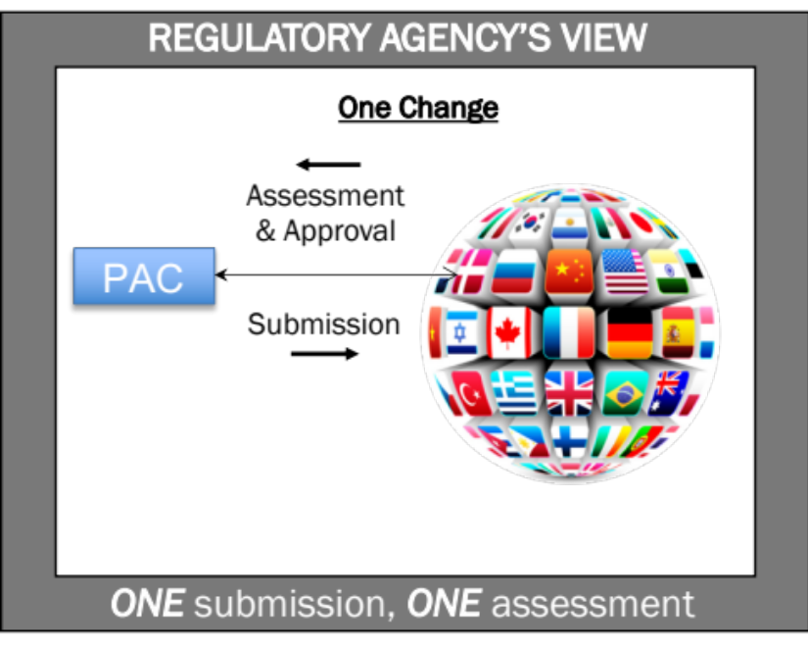
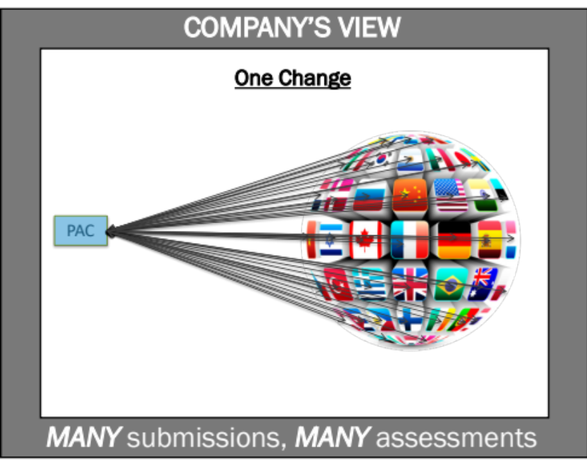
Global Regulatory Complexity
Ideally … close to real-time, but they can’t…
Many PACs require health authority approval prior to implementation
Prior approval PACs are approved separately in each country where the drug product is commercially available
Different countries have different assessment timelines, reporting levels, documentation requirements.
One change usually takes 3-5+ years for approval globally

Slide 13
Example of a PAC – Bigger Bioreactor
39 COUNTRIES
NO REPORTING
1 SUBMISSION WITH 6 PACs
7
PRODUCTS IMPACTED
LICENSED IN
138
COUNTRIES
37 COUNTRIES
MINOR CHANGE
62 COUNTRIES
MAJOR CHANGE
22 (of the 62)
COUNTRIES HAD
177
QUESTIONS OF WHICH
19
WERE DIFFERENT

Slide 14
…but there is more than one PAC……
Greatly simplified example
Note: pharma companies with drug products approved ‘worldwide’ have thousands of prior approval PACs each year
First approved version
1
2
3
4
5
6
7
8
9
10
11
12
Scientific & technical improvements
1
2
3
4
5
6
7
8
Country A
1
2
3
4
5
6
Country B
Each country Health Authority doing their own scientific evaluation of the same PAC independent of each other
1
2
3
4
5
Country C
1
2
3
Country D
Company managing 4 active versions at same time

Slide 15
The Global Regulatory Complexity
What does the system do?
What should the system be doing?
Disincentivizes and slows down continual improvement & innovation
Can cause supply disruptions (drug shortage)
Can cause GMP non-compliance
Manage the scientific evaluation of the PACs at a national/regional level independent from other countries
Taking years for full ‘global’ approval of each PAC
Have main objective (for all stakeholders) of uninterrupted supply of quality medicines to patients
Facilitate timely implementation of new knowledge globally
Appreciate diseases are global; supply chains are too
Be science and risk-based regarding reporting level & documentation requirements (in contrast to different from country to country)
Complete ‘global’ assessments in months
The problem has been known and discussed for two decades

Slide 16


Efficient, Agile, Flexible, Risk Management, Science
A 20-year journey so far…
“A maximally efficient, agile, flexible Pharmaceutical manufacturing sector that reliably produces high quality drugs without extensive regulatory oversight.”
"Develop a harmonized pharmaceutical quality system applicable across the lifecycle of the product emphasizing an integrated approach to quality risk management and science"
2002
2003
The Initiative Goals included:
Encourage the early adoption of new technological advances
Facilitate industry application of modern quality management techniques (quality systems)
Encourage implementation of risk-based approaches that focus both industry and Agency attention on critical areas
Agreement to develop the guidelines:
ICH Q8 Drug Product Development
ICH Q9 Quality Risk Management
ICH Q10 Pharmaceutical Quality System
ICH Q11 Drug Substance Development
FDA 21st Century Initiative:
a science and risk-based approach to product quality regulation incorporating an integrated quality systems approach
Quality New Paradigm

Slide 17
Developing the ICH Q8-11 Guidelines
A 20-year journey so far…
ICH Q10 Objectives
Achieve product realization
Establish and maintain a state of control
Facilitate continual improvement
The absence of an internationally harmonized pharmaceutical guideline can have impact:
Delays in the availability of medicines to patients
Delays in the implementation of innovation and continual improvement for existing products may occur due to different expectations in the three regions
Delays in the launch of new products
ICH Q10 BP 2005
When a company demonstrates effective PQS and product and process understanding, including the use of QRM there is an opportunity to optimise science and risk based post-approval change processes to maximise benefits from innovation and continual improvement
ICH Q10 Guideline 2008
2003
2005
2008
2009
2012
ICH Q8 CP
ICH Q8 Guideline
ICH Q9 BP & CP
ICH Q9 Guideline
ICH Q10 BP & CP
ICH Q10 Guideline
ICH Q11 BP & CP
ICH Q11 Guideline

Slide 18
ICH Q10 Did Not Meet Potential Benefits
.
1 = Things have gotten significantly worse/complex
2 = Things have gotten slightly worse/complex
3 = no change
4 = Things have improved slightly (less complex)
5 = Things have improved significantly (less complex)
Improved process performance
3.6
A reduction in the costs of internal failures (rejects, reworks, reprocessing and investigations) as the quality system guideline drives improvement
3.2
A reduction in the costs of holding duplicate stock and operating multiple processes as improvements and changes are made more effectively across all regions.
2.6
A reduction in the costs of preparing / reviewing certain regulatory submissions
2.5
Enhanced assurance of consistent availability to the patient
3.0
Since ICH Q10 was completed have have things progress on the Q10 BP potential benefits?
Response from 13 CQOs of the top 25 pharma companies OCTOBER 2021

Slide 19


ICH Q12
Pharmaceutical Product Lifecycle Management
A 20-year journey so far…
This guideline should enhance industry’s ability to manage many CMC changes effectively under the company’s PQS with less need for extensive regulatory oversight prior to implementation. This can incentivize continual improvement by providing an opportunity for greater flexibility in making post-approval changes. It could also result in fewer associated post-approval submissions to the MAA, and less associated regulatory burden.
ICH Q12 Guideline
The lack of harmonised approaches for technical and regulatory aspects for lifecycle management has hindered the anticipated innovation and continual improvement in the pharmaceutical and biotechnology sector.
ICH Q12 BP
“It is important to note that the legal framework always takes precedence over technical and scientific guidelines.”
EMA Note 2020
2014
2019
2020
ICH Q12 BP & CP
ICH Q12 Guideline
This guideline is not intended to introduce new requirements necessitating changes to the regulations in the regions.
EMA/CHMP/ICH/78332/2020
Note on EU implementation of ICH Q12

Slide 20
Impact of COVID-19 on PACs
COVID-19 demonstrated that the global regulatory framework is not agile enough to manage a pandemic – changes needed in days or week not months or years
Regulatory Agencies have used various ‘Emergency’ or ‘Exceptional’ ways to improve PAC agility and “down-grade” reporting level for some COVID-19 related PACs
Some Agencies have also relied more on the company’s own PAC assessments. Common characteristics include
  Formal application of Quality Risk Management (ICH Q9)
  Documentation of the company’s PAC assessment in the PQS (ICH Q10)
  Emphasize accountability of the Quality role (GMP)
These characteristics should be applied/explored also when there is no crisis
The ‘system’ is not capable of managing sudden change in demand

Slide 21
Two Dimensions that Will Reduce the Global Regulatory Complexity for faster implementation of changes and fewer drug shortages
SCIENCE &
RISK-BASED
Dimension 1: SCIENCE
Managing more PACs in the PQS only as agreed between regulators and industry in ICH Q10 Annex 1
PQS ONLY
PRIOR
APPROVAL
FOR LOW-RISK PACs
Note: > 99% of all prior approval PACs are approved
Dimension 2: RELIANCE
Encourage National Regulatory Agencies to rely more on other Regulatory Agencies (WLAs) for assessment of individual PACs following WHO guidance based on the 5 principles: Sovereignty, Transparency, Consistency, Legal basis, Competency

Slide 22
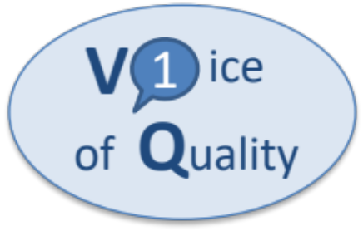
Which Batch Can be Released to Which Country?
The Daily Challenge for Chief Quality Officers (CQOs)
The CQOs of the top 25+ pharma companies have come together to speak with One-Voice-Of-Quality on the topic of PACs (1VQ on PAC)
The CQOs are
Accountable for their company’s PQS and its effectiveness
Responsible for release of safe, efficacious, quality medicines to the market
The CQOs are the first to define and publish what constitutes an effective PQS at system and individual PAC level since ICH Q10 was published.
The solution is in line with ICH Q9, Q10, Q12 and defines how many more PACs can be managed in the PQS only as outlined in ICH Q10 Annex 1
2014
2018
2019
2020
PDA TR68
1VQ on PAC
Initiative start
Concept Paper
Solution Paper
https://prst.ie/1vq/ (Industry 1VQ on PAC Initiative)

Slide 23
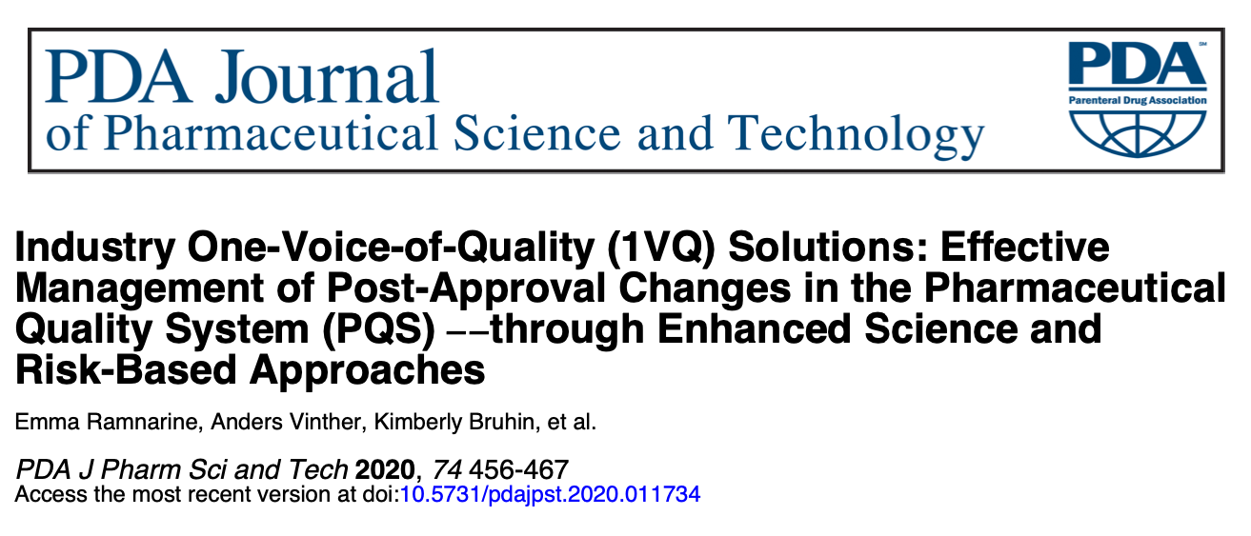
An Invitation to Dialog
https://prst.ie/1vq/ (Industry 1VQ on PAC Initiative)

Slide 24
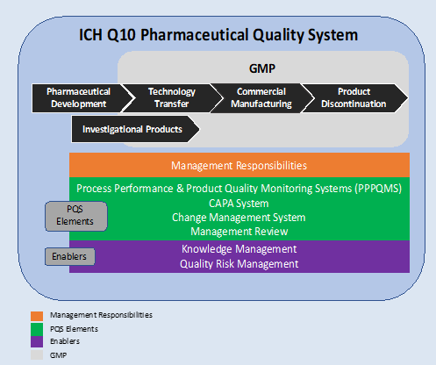
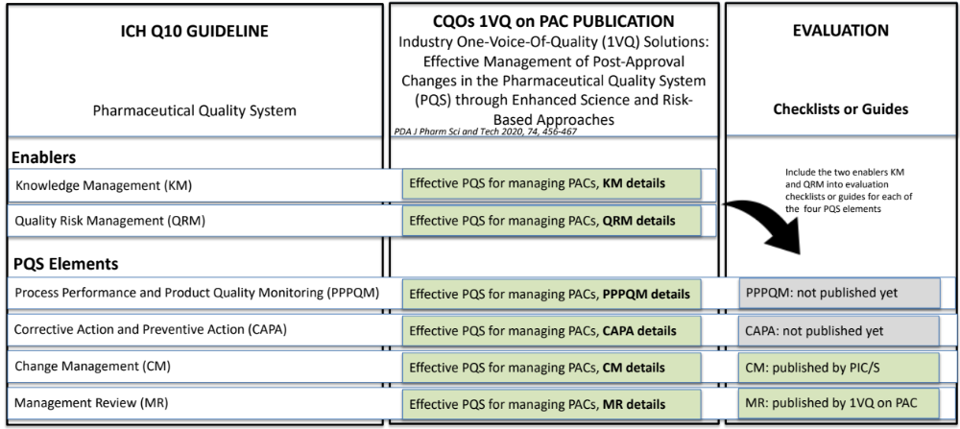
1VQ on PAC Have Defined Effective PQS at System Level
Note: This solution requires that pharmaceutical companies fully implement and demonstrate that they have an effective PQS for managing PACs
1VQ on PAC solution

Slide 25
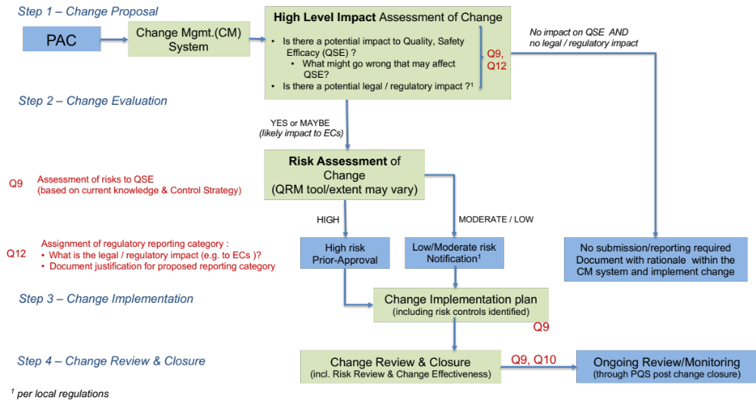
1VQ on PAC Have Defined Effective PQS at Individual PAC Level As Well
1
Standard and practical science and risk-based approach to PAC management
2
3
4

Slide 26

Global Pharmaceutical Quality Knowledge Management: Enhancing Regulatory Reliance and Agility
PQKMS
2021
“As the pharmaceutical industry is highly regulated, and the industry is globalized serving multiple markets, companies often must obtain these (prior approval PAC) approvals from multiple national regulatory bodies with different timeframes, therefore potentially delaying implementation of changes. ICMRA recognizes that regulatory authorities can gain efficiencies by developing common procedures, guidelines, requirements, and interoperable infrastructure that would facilitate the timely sharing of information on changes occurring within the supply chain”
A coordinated pharmaceutical quality knowledge management system:
Harmonized structured and standardized formats
Framework to support full harmonization of data elements
More extensive mutual reliance
“ICMRA is providing the global leadership and strategic vision to advance this work”

Slide 27
ICH Q9 (R1) Quality Risk Management
Revision 1 of the 2005 Guideline
2020
2021
BP & CP
Draft Guideline
Two risk management concepts emphasized
Formality in QRM
Risk-based decision making
“Decision makers should assure that subjectivity in QRM activities is controlled and minimized, to facilitate scientifically robust risk-based decision making”
Principles of QRM:
The evaluations of the risk to quality should be based on scientific knowledge and ultimately link to the protection of the patient. (Note: Risk to quality includes situations where product availability may be impacted, leading to potential harm)
The level of effort, formality and documentation of the QRM process should be commensurate with the level of risk
“Uncertainty may be reduced via effective knowledge management”
NEW!
“Robust management of risk is the goal …..based on evidence, science and knowledge, where risk scores, ratings or assessments are supported by data or by an appropriate justification or rationale”

Slide 28
Conclusion
If compliance dominates at the expense of science or vice versa there is a risk of stagnation, bureaucracy, chaos or confusion. Judgment calls made by Quality leaders are very important to ensure a healthy balance. The actions of these Quality leaders are also key to engage all employees
More guidelines or white papers are not going to solve the problem of global regulatory PAC complexity that disincentivizes companies to continually improve; a problem that has been discussed for at least two decades. Solving the problem in sub-parts also will not work. A holistic view is needed
There is a growing appreciation of the PAC problem by all stakeholders, which is the first step towards a commitment to change
The CQOs of the top 25+ companies have developed a solution for managing more PACs in the PQS only based on ICH Q10 Annex 1 and in line with stated objectives over the past two decades
The next steps must be collaboration between all stakeholder groups, reliance, harmonization, standardization and a science and risk-based approach to PAC assessment and implementation much closer to real-time
We need these next steps to solve the PAC problem and ensure uninterrupted supply of quality medicines to patients facilitated by an agile supply chain and an innovative industry

Slide 29
References
1VQ on PAC Initiative: https://prst.ie/1vq/
EMA/CHMP/ICH/78332/2020: Note on EU implementation of ICH Q12
EudraLex Vol 4
FDA 21st Century Initiative
ICH Q9 QRM
ICH Q10 PQS
ICH Q12 Pharmaceutical Product Lifecycle
ICMRA Global Pharmaceutical Quality Knowledge Management: Enhancing Regulatory Reliance and Agility (PQKMS)
Industry 1VQ on PAC: Effective Management of PACs in the PQS through enhanced science and risk-based approaches, PDA J Pharm Sci and Tech 2020, 74, 456-467
WHO: Good Reliance Practice; QAS/20.851

Slide 30
Acknowledgments
Emma Ramnarine, co-leader of the 1VQ on PAC Initiative and expert in QRM
Tina Morris, AAPS, many years of experience with international harmonization
Holger Rathgeber, expert in leadership and organizational development

Slide 31
Questions?
Anders Vinther, PhD
VP Quality Kronos Bio
avinther@kronosbio.com

