Slide 1
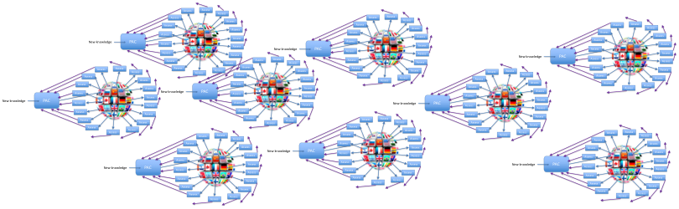
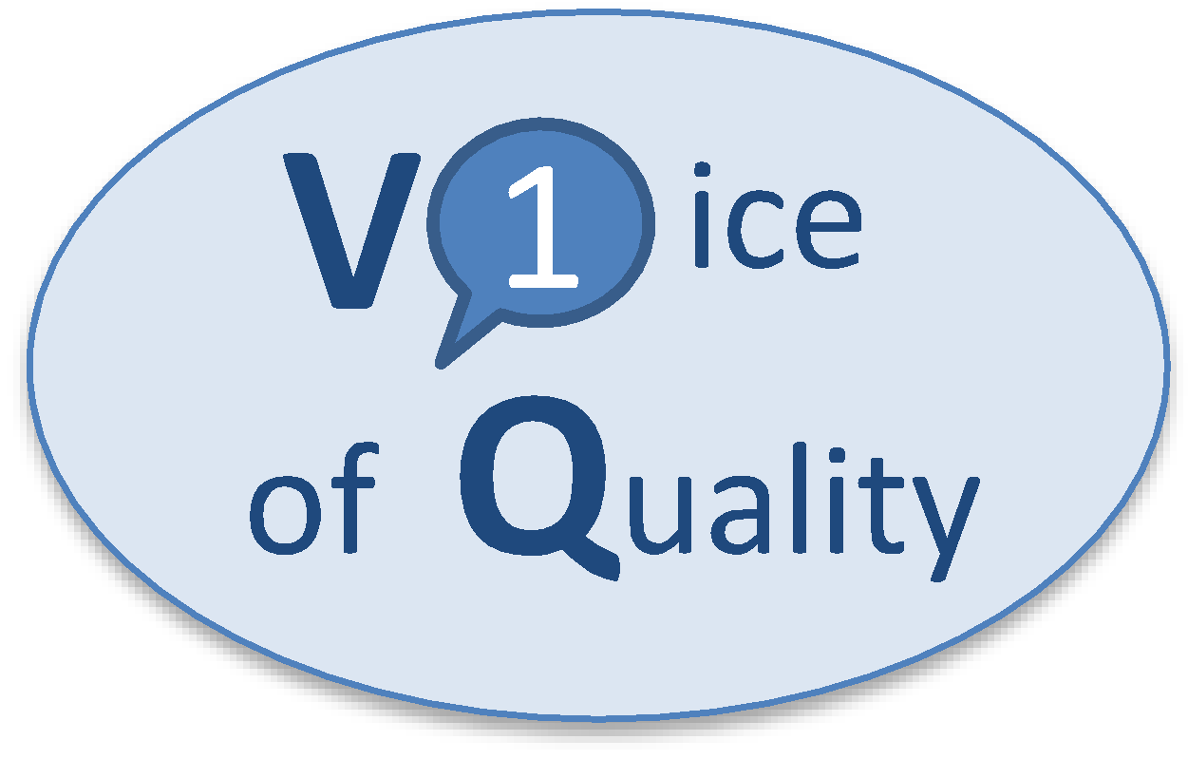
ONE-VOICE-OF-QUALITY FOR PACs (1VQ for PAC)
Industry Chief Quality Officers’ (CQOs) Perspectives
Risk-Based Change Management (PIC/S Paper)
How can we foster an environment with an incentive for industry to continually improve and reduce risk to patient?
Dr. Emma Ramnarine, São Paulo, 2 December 2022 – PIC/S QRM Expert Circle Meeting

Slide 2
What is the Right Balance?
1
“Blind-compliance”
SCIENCE
COMPLIANCE
SCIENCE
3
COMPLIANCE
“Non-compliance”
2
COMPLIANCE
SCIENCE
cGMP compliance is mandatory and common sense. Without applying science GMP compliance by itself cannot guarantee product quality
Slide acknowledgment: Dr. Anders Vinther
Notes:
The GMPs Developed in Response to Fatal Incidents

Slide 3
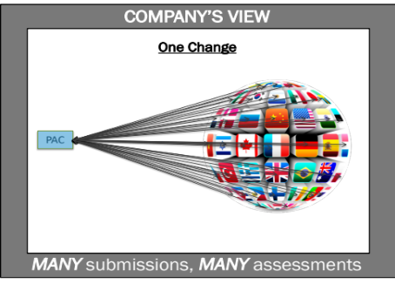
Post Approval Changes (PACs) are a Natural and Essential Part of a Pharmaceutical Product’s Commercial Lifecycle
Upgrading (aging) manufacturing and testing facilities and equipment
Maintaining cGMP compliance and a state of control
Implementing evolving regulatory requirements and new technologies
Emerging new knowledge about products and processes
Supplier changes
Continuous improvement
Post Approval Changes should be implemented timely and drive risk reduction,
but cannot be due to the global regulatory complexity
PAC approved by regulatory agencies before implementation
PAC assessed and validated by company
YEARS
Bringing a vaccine or drug product to market is not the finish line.
The objective for manufacturers is an uninterrupted supply throughout the product’s commercial lifecycle
One PAC, many national/regional submissions with different documentation requirements and different timelines

Slide 4
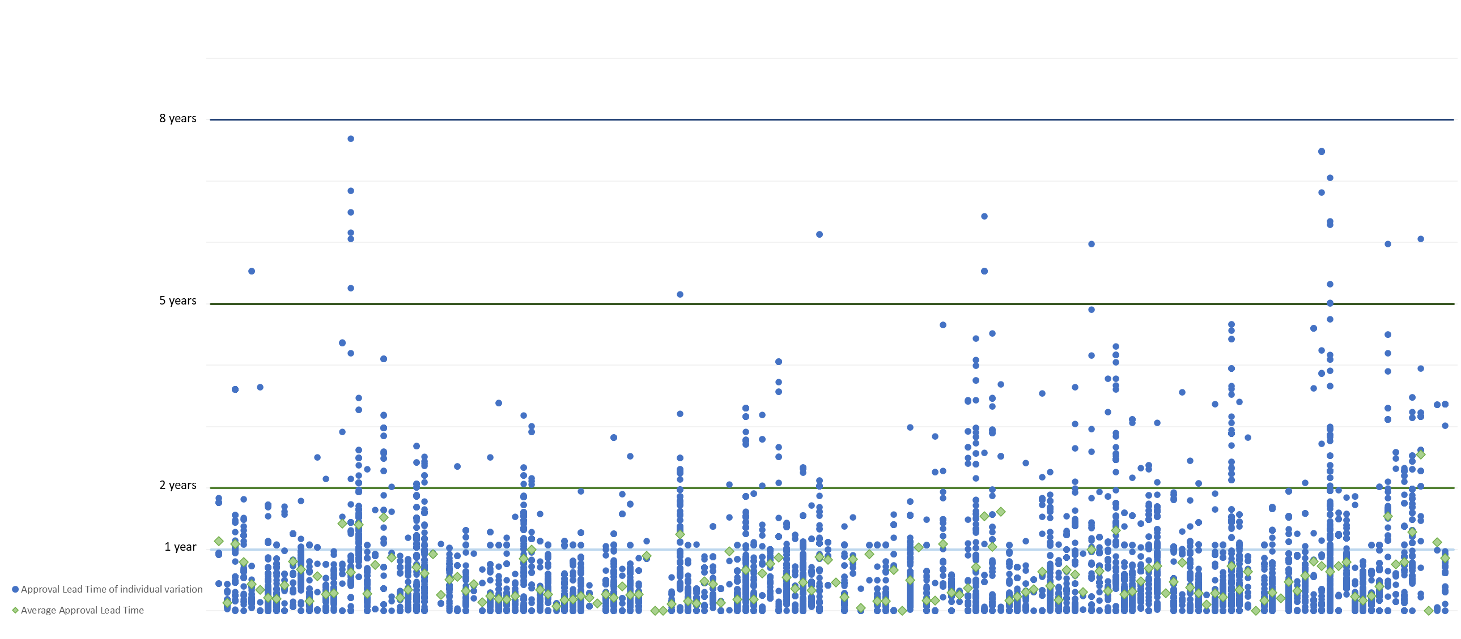
One company’s data 2019-2021

Slide 7
ICH Q10 Annex 1: Potential Opportunities to Enhance Science and Risk Based Regulatory Approaches and Regulatory Flexibility for PACs
Scenario | Potential Opportunity
1. Comply with GMPs | Compliance – status quo
2. Demonstrate effective pharmaceutical quality system, including effective use of quality risk management principles (e.g., ICH Q9 and ICH Q10). | Opportunity to: • increase use of risk based approaches for regulatory inspections.
3. Demonstrate product and process understanding, including effective use of quality risk management principles (e.g., ICH Q8 and ICH Q9). | Opportunity to: • facilitate science based pharmaceutical quality assessment; • enable innovative approaches to process validation; • establish real-time release mechanisms.
4. Demonstrate effective pharmaceutical quality system and product and process understanding, including the use of quality risk management principles (e.g., ICH Q8, ICH Q9 and ICH Q10). | Opportunity to: • increase use of risk based approaches for regulatory inspections; • facilitate science based pharmaceutical quality assessment; • optimise science and risk based post-approval change processes to maximise benefits from innovation and continual improvement; • enable innovative approaches to process validation; • establish real-time release mechanisms.

Slide 8
Why is the PIC/S Paper so Important?
Per ICH Q10 Annex 1
Criticality and risk level
QRM
(ICH Q9)
Effective CM = Effective PQS for PACs
Product & process knowledge & data
Product & process understanding
PIC/S Paper
Effective PQS
Company’s Change Management (CM) System
(PQS Element)
Submit to HA for prior approval?
Assessors assess
individual PAC submissions
All changes
(PACs + others)
Yes
Submit to HAs
Inspectors assess
GMP compliance & effectiveness of the CM system
No (PQS only)
…..
Implement

Slide 9

Why is the PIC/S Paper so Important?
Effective CM = Effective PQS for PACs
Sections 3.5 and 3.6 provide the basis for making a case for regulatory flexibility for PACs through demonstration of an effective CM system
“3.5 It is considered that application by a pharmaceutical manufacturer (including quality control laboratories) of the guidance set out in Section 5 below will provide evidence of the effectiveness of their PQS in relation to risk-based change management.”
“3.6 Effective change management is important not only in the context of the aforementioned PIC/S GMP requirements, but also in the context of ICH Q10, which sets out the potential for risk-based regulatory oversight for companies that demonstrate an effective PQS is in place (see Appendix 1). This guidance may also be useful in supporting implementation of the principles and concepts in the ICH Q12 guideline where mature risk-based change management within an effective PQS is considered foundational to enable greater regulatory flexibility in reporting of post-approval changes.”

Slide 10
ICH Q9 (R1) Quality Risk Management
Step 2 Draft (Dec 2021)
“Decision makers should assure that subjectivity in QRM activities is controlled and minimized, to facilitate scientifically robust risk-based decision making”
Two risk management concepts emphasized
Formality in QRM
Risk-based decision making
Principles of QRM:
The evaluations of the risk to quality should be based on scientific knowledge and ultimately link to the protection of the patient. (Note: Risk to quality includes situations where product availability may be impacted, leading to potential harm)
The level of effort, formality and documentation of the QRM process should be commensurate with the level of risk
“Uncertainty may be reduced via effective knowledge management”
NEW!
“Robust management of risk is the goal …..based on evidence, science and knowledge, where risk scores, ratings or assessments are supported by data or by an appropriate justification or rationale”
Notes:
Emma

Slide 11
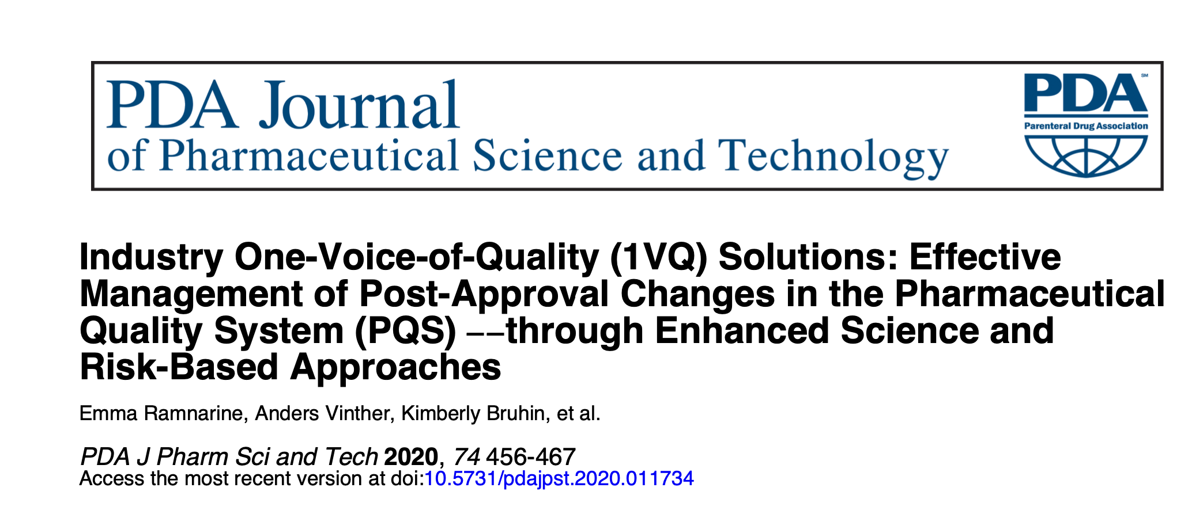
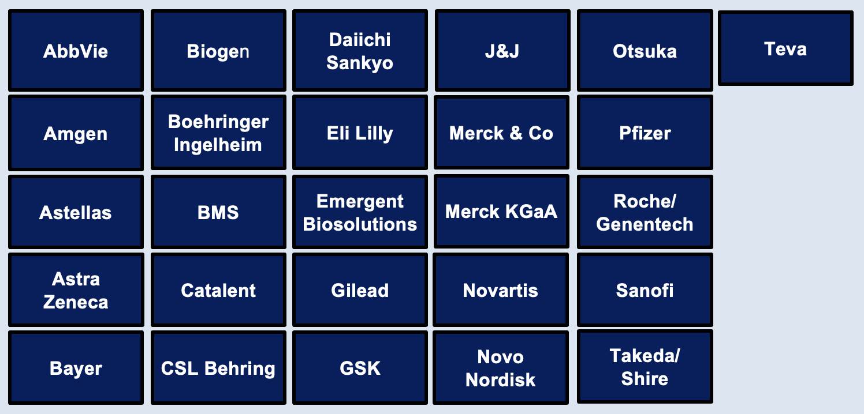
What is Unique about 1VQ for PAC Initiative?
Chief Quality Officers (CQOs) of top 25 pharma companies speaking with one voice because the global complexity is a threat to continued drug supply AND disincentivizes innovation and continual improvement
CQOs are the highest-level Quality decision makers; they own the PQS
Only Quality group pursuing ICH Q10 Annex 1 with the perspective of managing more PACs in the PQS - through practical solutions
Only group that has defined an effective PQS for the management of PACs – for all 4 PQS elements (PPPQMS, CAPA, CM, Management Review) and the 2 enablers (QRM, KM)
Senior regulators specifically asked for this group to be formed
1VQ for PAC Solutions Paper
1VQ for PAC Mgmt Review Paper
Notes:
Emma

Slide 12
CQOs Perspective on Value & Benefits the PIC/S Paper can Deliver (1 of 2)
Same paper for inspectors to evaluate the effectiveness of a company’s change management (CM) system, AND for companies to demonstrate that they can effectively manage PACs in their PQS
Clear link between the PIC/S Paper, ICH Q9, ICH Q10 Annex 1 and ICH Q12 in the application of science and risk-based approaches and using an effective PQS to gain regulatory flexibility for PAC management
ICH Q9 (R1) and PIC/S Paper (section 5.2) provide flexibility on the formality and effort for assessing changes commensurate with the criticality and impact (i.e., less formal risk assessments for minor and moderate changes)
Notes:
Anders 9-17

Slide 13
CQOs Perspective on Value & Benefits the PIC/S Paper can Deliver (2 of 2)
It is understood that regulatory flexibility cannot be freely offered upfront. It is up to companies to make the case for why they should be trusted and given regulatory flexibility. Demonstrating an effective PQS is key for this
  Demonstrate with data during inspections (since this is hard to include in a submission) that changes are implemented on time in full, in a compliant manner
  Providing evidence-based risk reduction will help build trust – 1) demonstrate clear understanding of risks 2) show how the risks have been controlled 3) provide evidence to support reduced risk
  During Inspection Opening Meeting companies can consider including how they can demonstrate PQS effectiveness for CM (in addition to demonstrating GMP compliance)
The timing is excellent right now to have these practical implementation conversations between inspectors and industry

Slide 14
For Discussion
The following are some open questions from the 1VQ for PAC Initiative that relate to the PIC/S Paper:
  Do inspectors think there is a need to document their assessment of PQS effectiveness within their inspection report? (Currently inspection reports primarily capture deficiencies)
  If yes, how might PQS effectiveness best be documented? If no, where else could PQS effectiveness assessment by inspectors be documented?
  Should overall PQS effectiveness be documented or just PQS Effectiveness with respect to the Change Management system?
  Would this require changes in the inspection report format?
  If yes, what might those changes be?
  How might PQS effectiveness be best communicated to assessors so that it can be considered in their review of PAC submissions?

Slide 15

Proposal for Consideration
A coordinated Pharmaceutical Quality Knowledge Management System (PQKMS):
Harmonized structured and standardized formats
Framework to support full harmonization of data elements
More extensive mutual reliance
“ICMRA is providing the global leadership and strategic vision to advance this work”
  Proposal for PIC/S QRM EC and ICMRA:
  Objective: Practical implementation of PIC/S Recommendation Paper by inspectors AND companies. Shift CM system assessment from based on GMP compliance → GMP compliance + demonstration of effective PQS
  Proposal: At least 2 joint working sessions with inspectors, assessors and 1VQ for PAC on how the PIC/S Paper can be used to assess effectiveness of a company’s CM system to determine if a PAC should be prior-approval OR can be managed in the PQS only
Notes:
ICMRA provides a global architecture to support enhanced communication, information sharing, crisis response and address regulatory science issues.
24 members, 15 associate members, WHO is observer
Chair: Dr. Emer Cooke
11 initiative, PQKMS one of them

Slide 17
Acknowledgement
Dr. Anders Vinther, Co-Lead 1VQ for PAC
Dr. Kevin O’Donnell
CQOs and companies participating in 1VQ for PAC Initiative
More info on 1VQ for PAC: https://prst.ie/1vq

